Slide 1
Character Set
The character set of C represents alphabet, digit or any symbol used to represent information.
Types | Character Set
Uppercase Alphabets | A, B, C, … Y, Z
Lowercase Alphabets | a, b, c, … y, z
Digits | 0, 1, 2, 3, … 9
Special Symbols | ~ ‘ ! @ # % ^ & * ( ) _ - + = | \ { } [ ] : ; " ' < > , . ? /
White spaces | Single space, tab, new line.

Slide 2
Token
Smallest unit in a program/statement.
It makes the compiler understand what is written in the program.
Example: main, printf , name,), etc.
Tokens are broadly classified as:
  Identifiers
  Keywords
  Constants
  Variables
  Strings
  Operators
  Special character

Slide 3
Identifiers
So to identify things we have some name given to them .
Identifiers are the fundamental building blocks of a program
Used to give names to variables, functions, constant, and user defined data.
They are user-defined names and consist of a sequence of letters and digits
Notes:
Variable is data name used for storing a data value

Slide 4
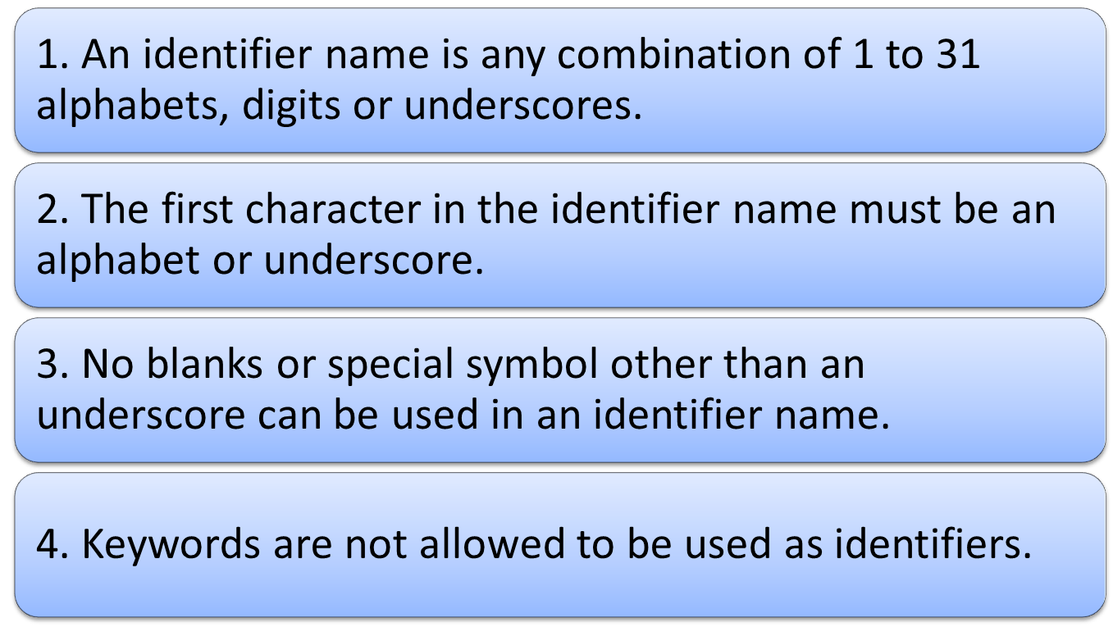
Rules for naming an Identifier

Slide 5

Some Identifiers
Tool_spanner;
tool_spanner;
FORMULA1;
engine_1;
both are different
Wrong identifiers name
1_engine;
break;
@car-roof;

Slide 6


Keywords
Keywords are the reserved words whose meaning has already been explained to the C compiler.
We cannot use these keywords as variables.
Each keyword is meant to perform a specific function in a C program.
There are 32 keywords in C language.
All keywords are written in lowercase only
Quick yak:
Ask students some of the keywords i.e. words which are by themselves and cannot be used for anything else ex: left, right…
Eg: The name of person can never be home, eat, sleep, run, etc because these words have some predefined meaning to perform some task.

Slide 7
List of C Keywords
auto | double | int | struct
break | else | long | switch
case | enum | register | typedef
char | extern | return | union
const | float | short | unsigned
continue | for | signed | void
default | goto | sizeof | volatile
do | if | static | while

Slide 8
Data Types
Data type means the type of value a variable can store.
It also defines memory space for a particular variable in computer.
The type of value of variable can be alphabets or integers or decimal values(float).
The numbers can be further divided as the integer or rational numbers(float).

Slide 9
Classification of Data Types
In C data type is broadly classified as:
  Basic data types
  Derived data types
  User defined data types

Slide 10
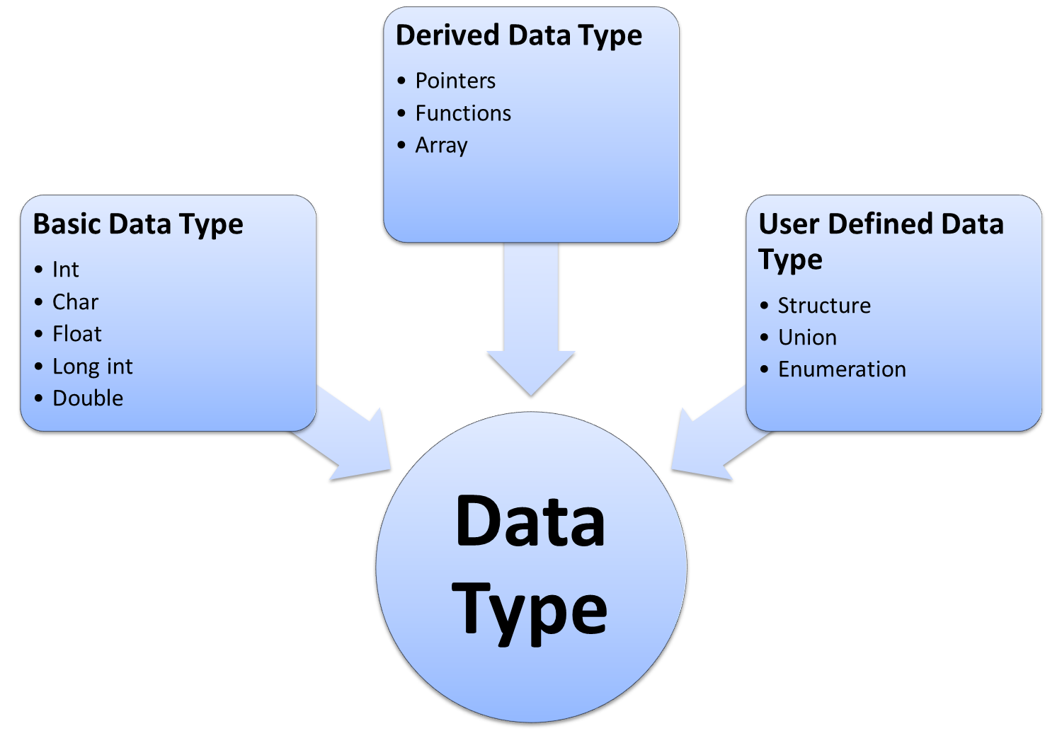

Slide 11
List of Data Types
Type | Size (bytes) | Minimal range
char | 1 | -128 to 127
unsigned char | 1 | 0 to 255
int | 2 or 4 | -32768 to 32767
unsigned int | 2 or 4 | 0 to 65535
short int | 2 | -32768 to 32767
unsigned short int | 2 | 0 to 65535
long int | 4 | -2147483648 to 2147483647
unsigned long int | 4 | 0 to 4294967295
float | 4 | 3.4e-38 to 3.4e+38 with 6 digits of precision
double | 8 | 1.7e-308 to 1.7e+308 with 15 digits of precision
long double | 10 | 3.4e-4932 to 1.1e+4932 with 20 digits of precision

Slide 12
Constants
The entity which do not change throughout the execution are called constants.
Types of constants:
  Integer constant
  Character constant
  Floating point constants
  String constants
Name of person remains same through out the life, example: Amit, Shubnam, etc.

Slide 13
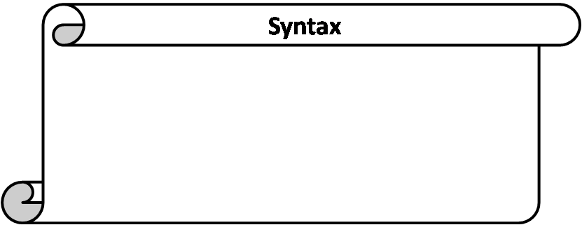
Variables
Variable is a location in memory which may change its value..
Variable is used to hold result and reserve memory for the data.
datatype variable_name;
The naming of variable is done by following the same rules of identifier naming.
Eg. What is your hobby?
The answer could be reading, dancing, drawing, etc.
So the answer to such questions may change during the life time of the person

Slide 14
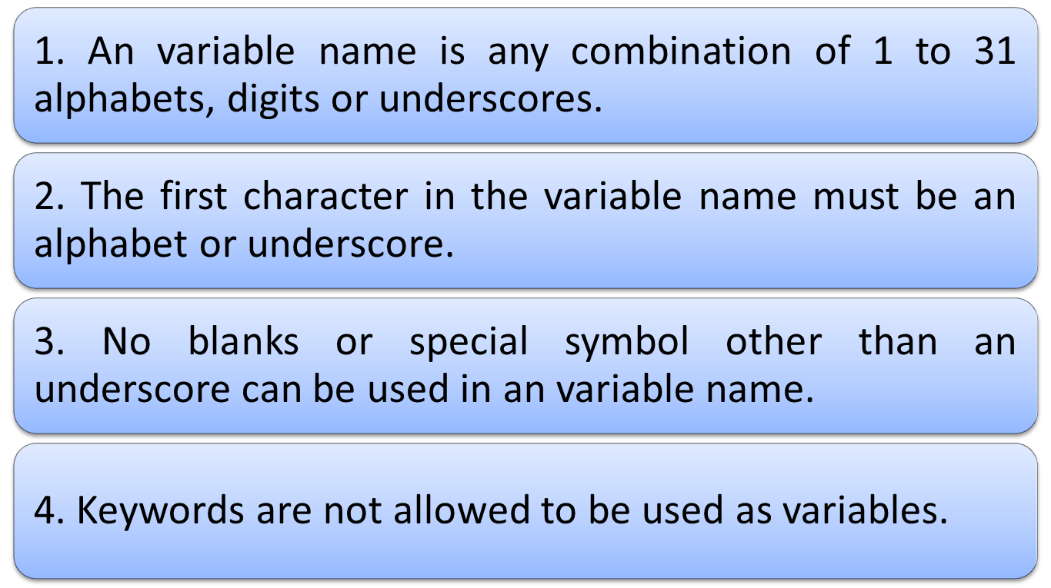
Rules for naming a Variable

Slide 15
Expressions
Expressions are the statements or the instruction given to computer to perform some operation.
Every expression results in some value that can be stored in a variable.
Following are few example of expressions in program:
  Expression to calculate speed of a car.
    Speed=distance/time
  Expression to find similarity of two things.
    c=value1>value2
Notes:
A=b+c….three operands and 2 operators

Slide 16
Expressions in C are basically operators acting on operands.
An operand is an entity on which operation is to be performed.
An operator specifies the operation to be applied on operands.
Expressions are made of one or more operands.
Statements like :
a = b + c,
++z
300 > (8 * k)
Example: addition of two numbers, 5+8, these numbers will be operands.
Example: The addition, subtraction, etc will be operators

Slide 17
Operators
Operator is the symbol which performs some operations on the operands.
5+5=10
+ and = are the operator and
5 and 10 are operands

Slide 18
Types of Operators
Types of operators are:
  Arithmetic operator
  Unary operator
  Relational operator
  Logical operator
  Assignment operator
  Conditional operator
  Bitwise operator
  Special operator

Slide 19
Description of Operators
Arithmetic Operators
These are binary operators i.e. expression requires two operands
Operator | Description | Example (a=4 and b=2)
+ | Addition of two operands | a + b = 6
- | Subtraction of two operands | a – b = 2
* | Multiplication of two operands | a * b = 8
/ | Division of two operands | a / b = 2
% | Modulus gives the remainder after division of two operands | a % b = 0

Slide 20
Unary Operator
These operator requires only one operand.
Operator | Description | Example(count=1)
+ | unary plus is used to show positive value | +count; value is 1
- | unary minus negates the value of operand | -count; value is -1
++ | Increment operator is used to increase the operand value by 1 | ++count; value is 2 count++; value is 2
-- | Decrement operator is used to decrease the operand value by 1 | --count; value is 1 count--; value is 1
++count increments count by 1 and then uses its value as the value of the expression. This is known a prefix operator.
count++ uses count as the value of the expression and then increments count by 1. This is known as postfix operator.

Slide 21
Relational Operator
It compares two operands depending upon the their relation. Expression generates zero(false) or nonzero(true) value.
Operator | Description | Example (a=10 and b=20)
< | less than, checks if the value of left operand is less than the value of right operand, if yes then condition becomes true. | (a < b) value is 1(true)
<= | less than or equal to, checks if the value of left operand is less than or equal to the value of right operand, if yes then condition becomes true. | (a <= b) value is 1 (true).
> | greater than, checks if the value of left operand is greater than the value of right operand, if yes then condition becomes true. | (a > b) value is 0 (not true).
>= | greater than or equal to, checks if the value of left operand is greater than or equal to the value of right operand, if yes then condition becomes true. | (a >= b) value is 1 (true).
== | equality ,checks if the value of two operands is equal or not, if yes then condition becomes true. | (a == b) value is 0 (not true).
!= | inequality, checks if the value of two operands is equal or not, if values are not equal then condition becomes true. | (a != b) value is 1 (true).

Slide 22
Logical Operator
  It checks the logical relationship between two expressions and the result is zero( false) or nonzero(true).
Operator | Description | Example
&& | Logical AND operator. If both the operands are true then condition becomes true. | (5>3 && 5<10) value is 1 (true).
| | | Logical OR Operator. If any of the two operands is true then condition becomes true. | (5>3 || 5<2) value is 1 (true).
! | Logical NOT Operator. Use to reverses the logical state of its operand. If a condition is true then Logical NOT operator will make false. | !(8==8) value is 0 (false).

Slide 23
Assignment Operator
They are used to assign the result of an expression on right side to a variable on left side.
Operator | Description | Example(a=4 and b=2)
+= | a=a+b | a+=b; a=a+b = 6
-= | a=a-b | a-=b; a=a-b = 2
*= | a=a*b | a*=b; a=a*b = 8
/= | a=a/b | a/=b; a=a/b = 2
%= | a=a%b | a%=b; a=a%b = 0
>>= | a=a>>b | a=00000100 >> 2 = 00010000
<<= | a=a<<b | A=00000100 << 2 = 00000001
&= | a=a&b | (a=0100, b=0010) a&=b; a=a&b = 0000
|= | a=a|b | (a=0100, b=0010) a|=b; a=a|b =0110
^= | a=a^b | (a=0100, b=0010) a^=b; a=a^b = 0110

Slide 24
Conditional Operator
Conditional operator contains condition followed by two statements. If the condition is true the first statement is executed otherwise the second statement.
It is also called as ternary operator because it requires three operands.
Operator | Description | Example
?: | conditional expression, Condition? Expression1: Expression2 | (a>b)? “a is greater”: “b is greater”

Slide 25
Bitwise Operator
A bitwise operator works on each bit of data.
Logical Table
a | b | a & b | a | b | a ^ b
0 | 0 | 0 | 0 | 0
0 | 1 | 0 | 1 | 1
1 | 1 | 1 | 1 | 0
1 | 0 | 0 | 1 | 1
Operator | Description | Example(a=1 and b=0)
& | bitwise AND | a & b = 0
| | bitwise OR | a| b = 1
^ | bitwise XOR | a ^ b = 1
~ | bitwise one’s complement | ~a = 0, ~b=1
<< | bitwise left shift, indicates the bits are to be shifted to the left. | 1101 << 1 = 1010
>> | bitwise right shift, indicates the bits are to be shifted to the right. | 1101 >> 1 = 0110

Slide 26
Some Special Operators
Operator | Description | Example
, | comma operator, can be used to link the related expressions together | int a, b, x;
sizeof () | sizeof operator to find the size of an object. | int a; sizeof(a)=2
type | Cast operator, to change the data type of the variable | float x= 12.5; int a; a = (int) x; value of a is 12.

Slide 27
Precedence of Operators
The precedence of operators determine a rank for the operators. The higher an operator's precedence or priority, the higher “binding” it has on the operands.
Example: So how the expression a * b + c will be interpreted?
(a * b) + c or a * (b + c),
here the first interpretation is the one that is used because the multiplication operator has higher precedence than addition.

Slide 28
Associativity of Operators
Associativity tell us the order in which several operators with equal precedence are computed or processed in two directions, either from left to right or vice-versa.
Example: In the expression
a * b / c,
since multiplication and division have the same precedence we must use the associativity to determine the grouping. These operators are left associative which means they are grouped left to right as if the expression was
(a * b) / c.

Slide 29
Operator | Associativity | Type
() [] . -> ++(postfix) - - (postfix) | left to right | Highest
+ - ++ -- ! & * ~ sizeof (type) | right to left | Unary
* / % | left to right | multiplicative
+ - | left to right | additive
<< >> | left to right | shifting
< <= > >= | left to right | relational
== != | left to right | equality
& | left to right | bitwise AND
^ | left to right | bitwise OR
| | left to right | bitwise OR
&& | left to right | logical AND
|| | left to right | logical OR
?: | right to left | conditional
= += -= *= /= &= |= ^= <<= >>= %= | right to left | assignment
, | left to right | comma

Slide 30
Parts of a C++ Program
comment
// sample C++ program
#include <iostream>
using namespace std;
int main()
{
cout << "Hello, there!";
return 0;
}
preprocessor
directive
which namespace
to use
beginning of
function named main
beginning of
block for main
output
statement
string
literal
end of block
for main
send 0 to
operating system
2-<number>
Notes:
Main function contain two types of code :defination and statements
Defination describes the data that that will b used in function.
Statement is the set of instruction.

